Slide 1
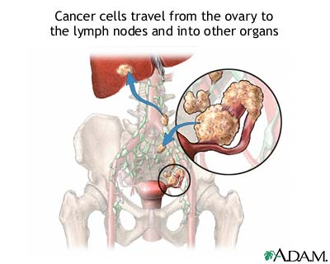
Ovarian Cancer

Slide 2
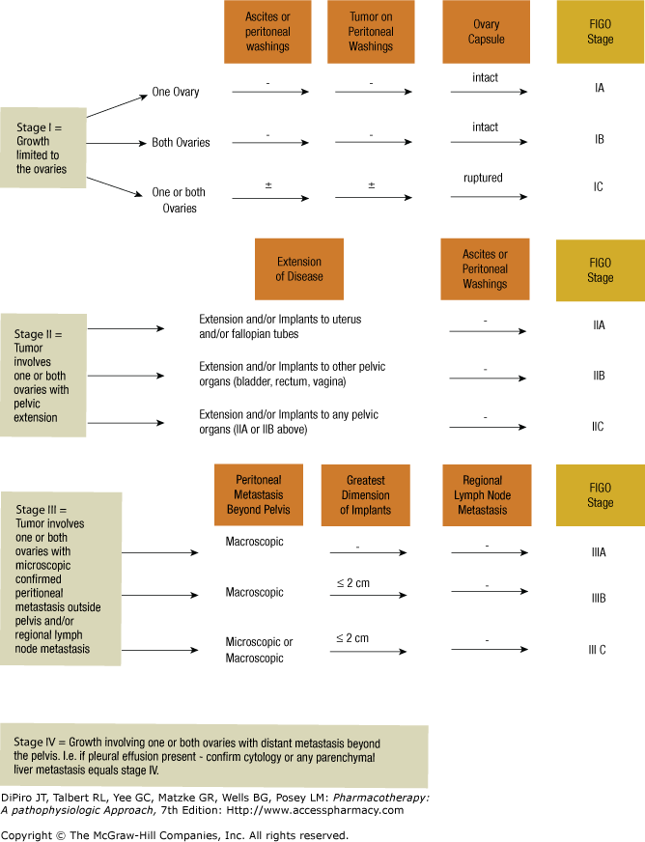
Classify Ovarian Cancer Stage

Slide 3
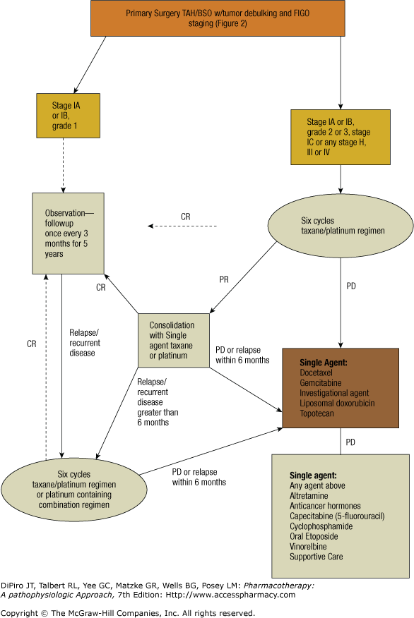
CR: complete remission
PD: progressive disease

Slide 4
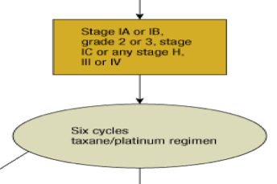
Chemotherapy for Ovarian Cancer
Taxane + Platinum
Drugs | Cycle
Carboplatin AUC 5-7 + Paclitaxel 175mg/m2 | Q 21 d
or
Cisplatin 75mg/m2 + Paclitaxel 135mg/m2 | Q21 d
or
Cisplatin 50-100 mg/m2 + Cyclophosphamide 600 mg/m2 | Q 21-28 d

Slide 5
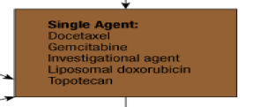
Salvage Therapy:
When pts relapse within 6 months
Drug | Dose | Cycle
Docetaxel | 60 mg/m2 IV | Q21 days
Gemcitabine | 800-1,000 IV mg/m2 | weekly
Liposomal doxorubicin | 50mg/m2 IV q21d | Q21 days
Topotecan | 1.5mg/m2 | IV q day x 5 days, q21 days
Etoposide | 50mg/m2 PO | Daily x 21 days cycle q 28 days
Paclitaxel | 60-80 mg/m2 IV | weekly
Bevacizumab** | investigational | weekly

